Slide 1
Predicting and Analyzing Language Specificity in Social Media Posts
Yifan Gao*, Yang Zhong*, Daniel Preotiuc-Pietro and Junyi Jessy Li
UT Austin
UT Austin
Bloomberg LP
UT Austin
* Equal contribution

Slide 2
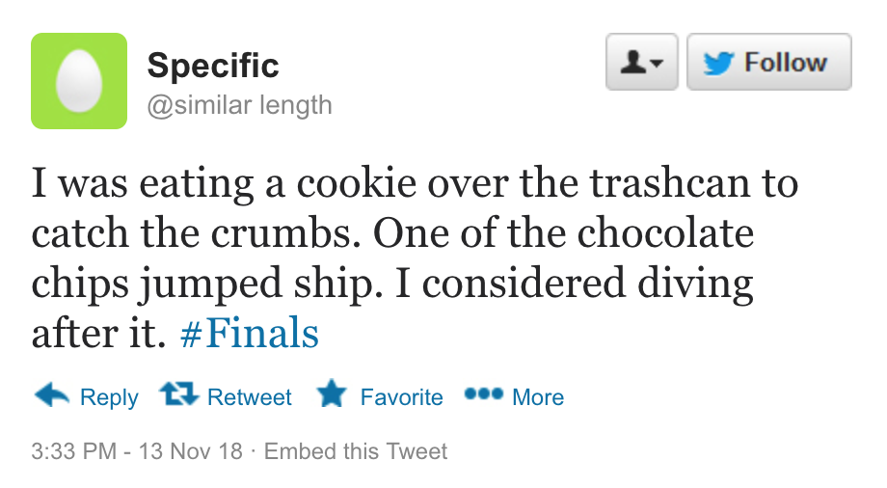
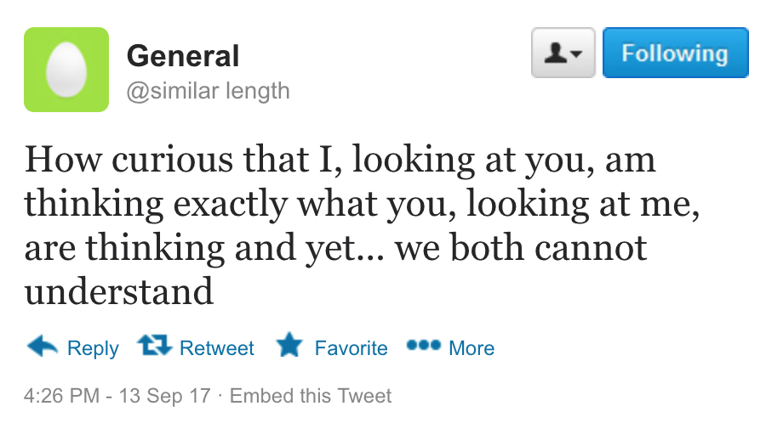
Motivation

Slide 3
Specificity
Texts vary in their levels of detail and their involvement of particular concepts, objects and events, i.e., their specificity.
The quality of belonging or relating uniquely to a particular subject. -- Oxford Dictionary

Slide 4
Language specificity
Impacts reading comprehension
(Dixon 1987)
Connected to several discourse relations
(Mann and Thompson 1988)
Potentially linked to autism
(Li et al. 2017)
Notes:
Several Linguists showed that the organization of general and specific information in text impacts reading comprehension speed (Dixon 1987).
In discourse analysis, specificity is connected with several discourse relations (Mann and Thompson 1988)
Prior work in clinical psychology explored potential links between specificity and autism (Li et al. 2017).

Slide 5
NLP applications
Dialogue generation
systems favor generic responses such as “I don’t know”
(Sordoni et al., 2015; Mou et al., 2016; Li et al 2017)
Text summarization
(Louis and Nenkova, 2011)
Text quality prediction
(Louis and Nenkova, 2013)
Argumentation mining
(Swanson et al., 2015)
Assessing classroom discussions
(Luo and Litman, 2016; Lugini and Litman, 2017)
Notes:
Text specificity has been shown to be important in many AI-related applications.

Slide 6
Specificity prediction: current state
Training data on news corpora
Training labels are binary (sentence is either general or specific)

Slide 7
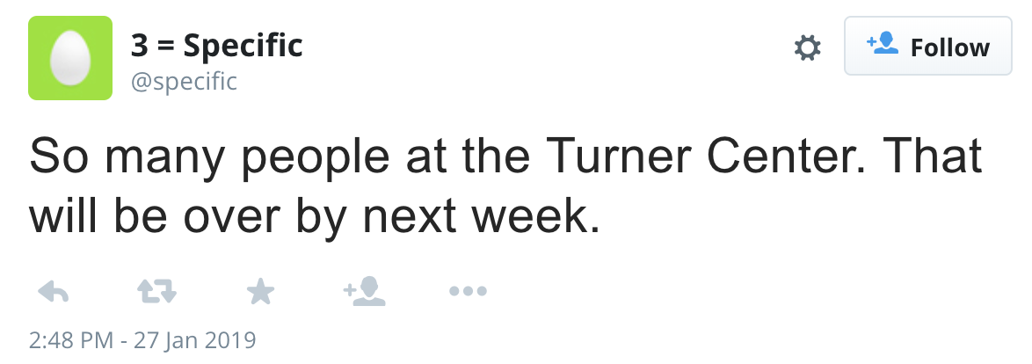
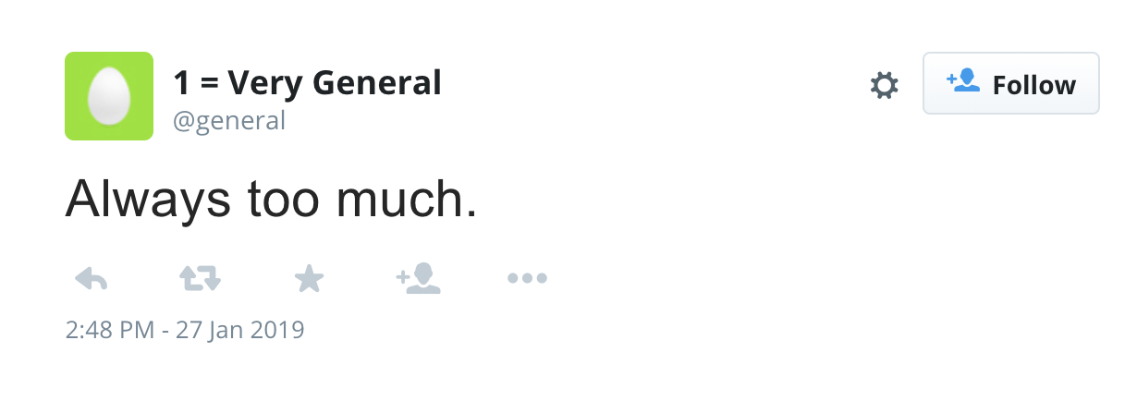
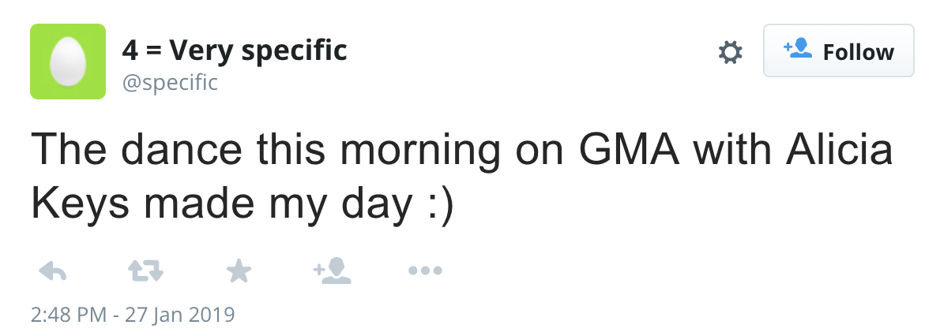
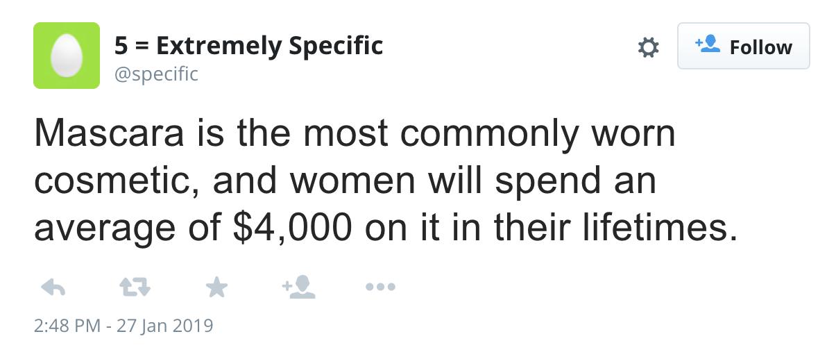
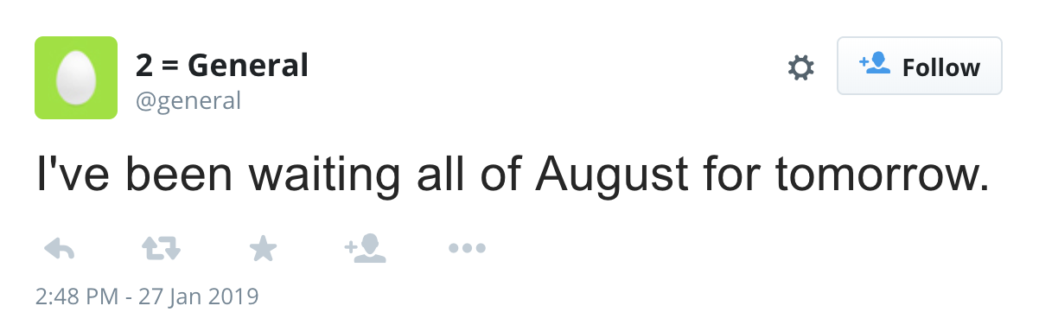
Specificity
A fine grained scale for specificity.

Slide 8
Research Questions
Do personal traits impact one’s language specificity?
Do temporal factors impact specificity?
Can language specificity be predicted accurately?
Is specificity prediction useful in a downstream task?
1
2
3
4
Notes:
We asked the following research questions...

Slide 9
Agenda
Data
Demographic Analysis
Temporal Analysis
Modeling
Task-based evaluation: mental health (depression) analysis

Slide 10
Data
We introduce a data set of tweets annotated with specificity
7267 tweets
Sourced from 3665 users with self-reported demographic information
(Preotiuc-Pietro et al., 2017)
Gender, age, education, income level, faith, political ideology
Corpus and code available at https://github.com/cs329yangzhong/specificityTwitter

Slide 11
Data
Annotated for specificity
5-point Likert scale
MTurk
IAA - Krippendorf’s Alpha of 0.507
≥ 5 annotations/instance
QC - experienced US workers; excluded annotators with <0.3 agreement with majority of others
Specificity score - average of annotations
Notes:
Annotated for specificity
on a 5-point scale
Each tweet annotated by ≥ 5 workers
Quality control:
Experienced, reliable worker located in the US
Annotator with agreement < 0.3 excluded.
Moderate agreement with 0.507 Krippendorf’s Alpha (interval) value
Average of scores used as consolidated specificity score.

Slide 12
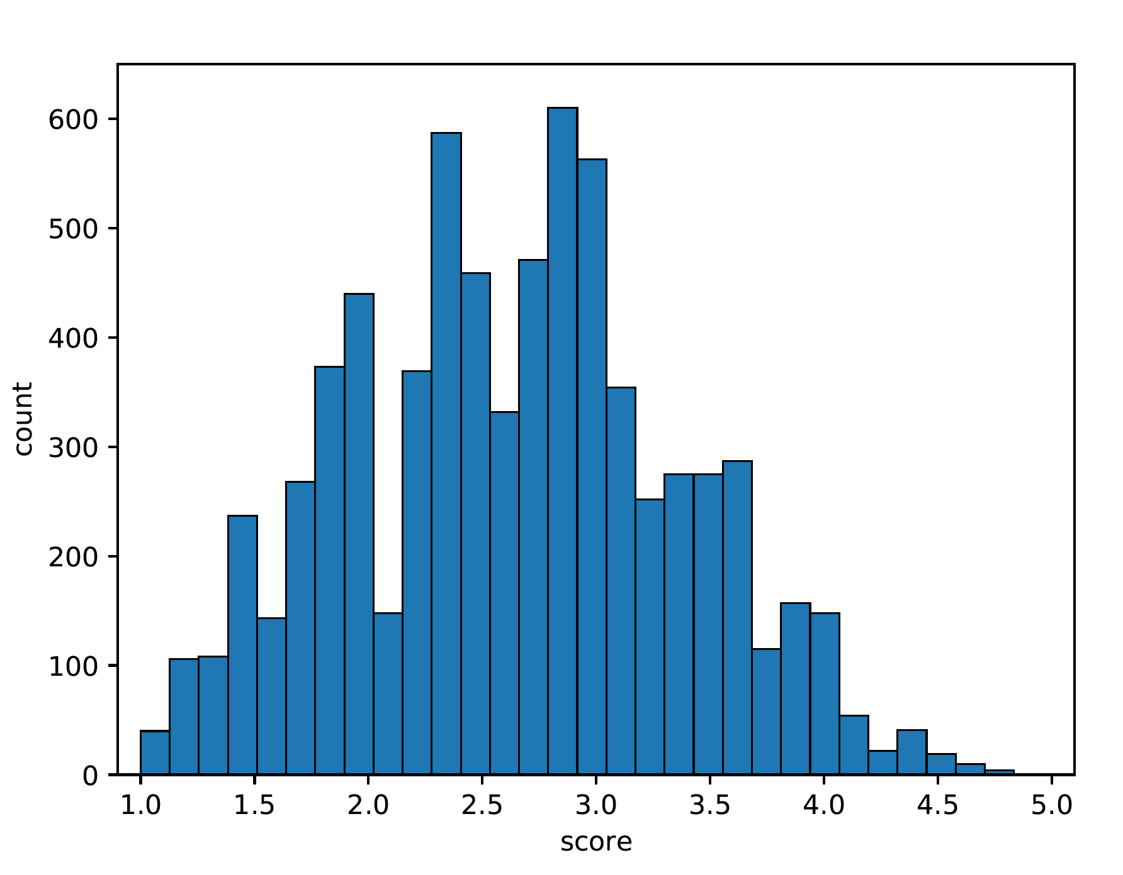
Specificity distribution
Most tweets fall in the middle of the specificity spectrum
Shows the utility of the fine-grained rating scale
Notes:
Most tweets are a mixture of general and specific information

Slide 13
Research Questions
Do personal traits impact one’s language specificity?
Do temporal factors impact specificity?
Can language specificity be predicted accurately?
Is specificity prediction useful in a downstream task?
1
2
3
4

Slide 14
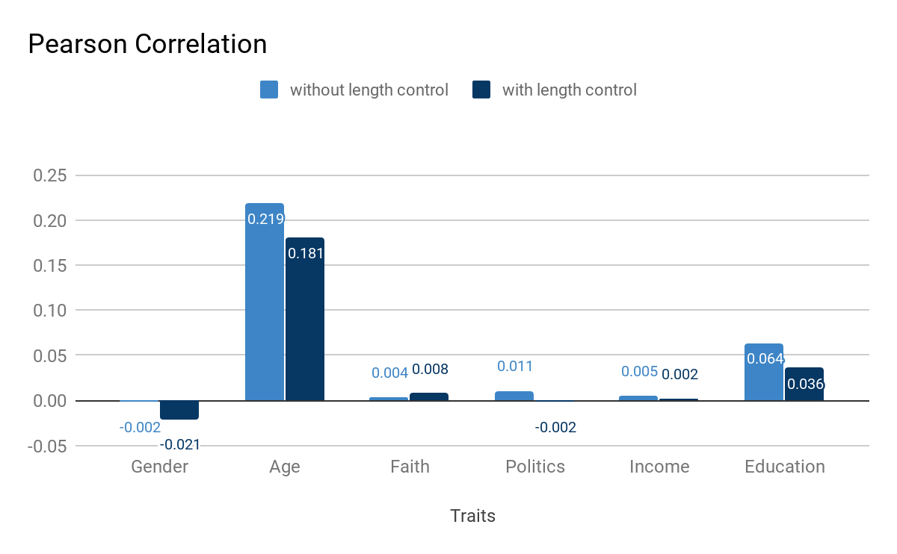
Demographic Analysis
Pearson Correlation
Dependent variable:
average specificity
(per user)
Control for gender & age
Control for tweet length
- Bonferroni corrected for multiple comparisons

Slide 15
Demographic Analysis
Specificity is correlated to:
Age
Correlation remains significant after controlling for tweet length
Education
Even when controlled for age

Slide 16
Research Questions
Do personal traits impact one’s language specificity?
Yes!
1

Slide 17
Research Questions
Do personal traits impact one’s language specificity?
Do temporal factors impact specificity?
Can language specificity be predicted accurately?
Is specificity prediction useful in a downstream task?
1
2
3
4

Slide 18
Temporal Analysis
Subset of 4716 tweets can be recovered to their local post time from tweet metadata.
Example:
Original: Mon Dec 21 01:33:05 +0000 2015 -18000
Fixed: Mon Dec 20 20:33:05 +0000 2015 (Correct Local Time)

Slide 19
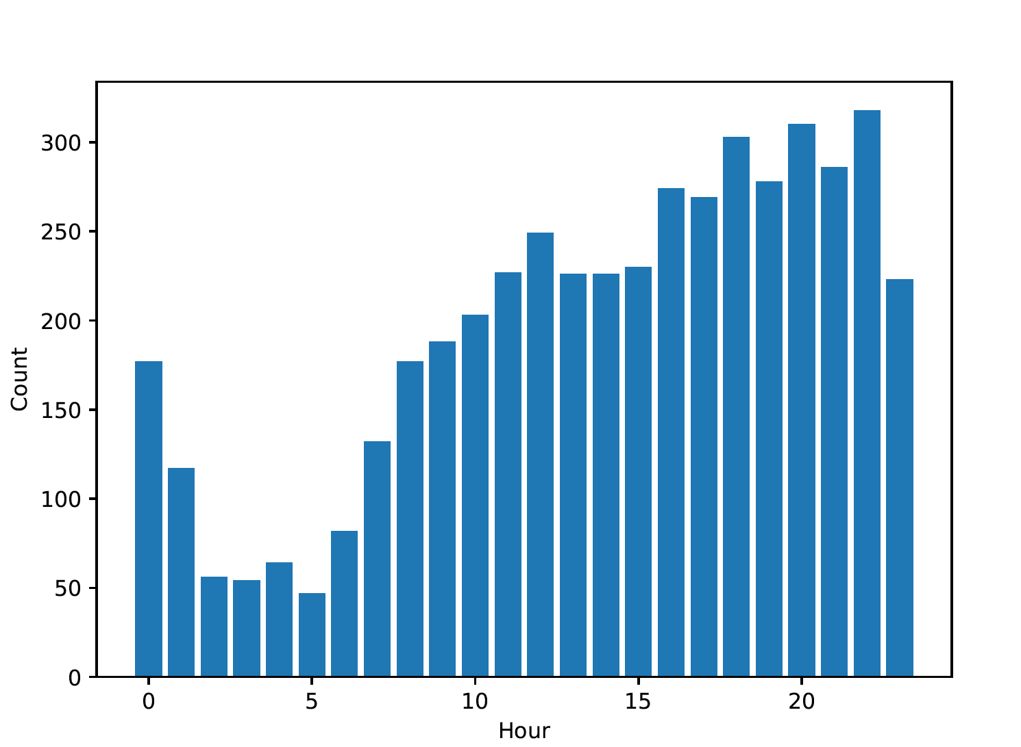
Temporal Analysis
# tweets posted across hours of a day.

Slide 20
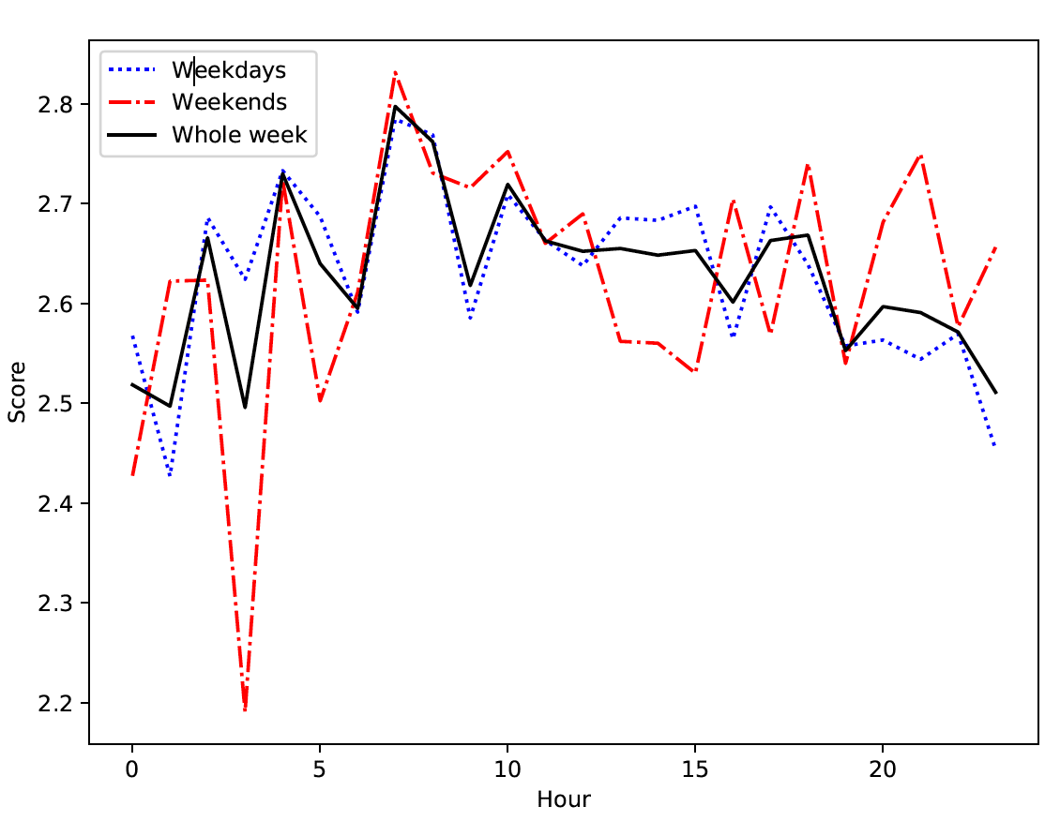
Temporal Analysis
Morning tweets are more specific
Specificity decreases throughout the day
People tweet less specifically in the evening despite tweeting more frequently
Average tweet specificity throughout the day.

Slide 21
Research Questions
Do temporal factors impact specificity?
Yes!
2

Slide 22
Research Questions
Do personal traits impact one’s language specificity?
Do temporal factors impact specificity?
Can language specificity be predicted accurately?
Is specificity prediction useful in a downstream task?
1
2
3
4

Slide 23
Feature Types
Surface and lexical features
Tweet content
Social media content
Emotion features

Slide 24
Surface and Lexical features
Named Entities
Indicators of named entities from seven categories:
Location, Person, Organization, Money, Percent, Date, and Time
Part-of-speech Tag (POS)
POS Tag count over eight categories:
determiners, nouns, proper nouns, pronouns, adjectives, prepositions, and punctuation.
Concreteness Score
Average word concreteness score using a lexicon
(Brysbaet, Warriner and Kuperman 2014)

Slide 25
Surface and Lexical features
String surface features
Tweet length (number of tokens)
Average word length
Percent of:
capital letters
numbers
non-alphanumeric symbols including punctuation marks

Slide 26
Tweet Content
Word Embeddings
Average of the embeddings of words in the tweet
Pre-trained GloVe word embeddings trained over 2 billion tweets
(Pennington, Socher, and Manning 2014)
Brown Clusters
Count of words in each pre-trained cluster divided by the tweet length.
(Turian, Ratinov, and Bengio 2010)

Slide 27
Social Media Content
Captures specific Twitter behaviors:
URLs
Contains user mentions
Is a reply

Slide 28
Emotion Features
Emotional and subjective tweets tend to be less general
(Li and Nenkova 2015, 2016)
Indicators of positive and negative words
Using a sentiment lexicon of 6,800 English words
(Hu and Liu, 2004)
The percentage of tokens that are emojis

Slide 29
Predictive Baselines
Average
Average specificity from training data
Tweet length
Tweet length as the only feature in a SVR model
Speciteller
The only available sentence specificity predictor
Trained on news corpora (Li and Nenkova 2015)

Slide 30
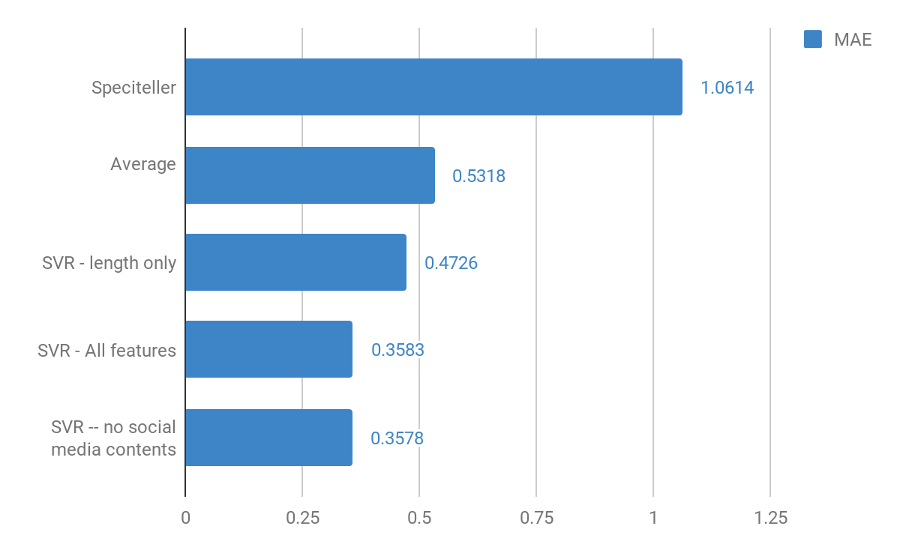
Modeling Results
Support Vector Regression
Data Split:
Train: 5767
Dev: 500
Test: 1000
Result:
Significantly outperforms all baselines
Lower is better.

Slide 31
Examples
Tweet | Gold | Speciteller | Tweet Length | Our model
IM HYSTERICALLY CRYING IM SO PROUD OF THEM | 1.86 | 4.91 | 2.33 | 2.15
It’s November!!!!! Crunch Time Bro!!!! Let’s Do It!!! | 2.43 | 4.92 | 2.96 | 2.37
just reached level 15 on Paradise Island on my Android. | 3.63 | 3.77 | 2.50 | 3.59
I'm at Macadams Bar & Grill (5833 SW Macadam Ave, Portland) | 4.25 | 4.96 | 2.86 | 3.87
Capital letters and symbols often go with specific info in formal writing
Length alone cannot estimate specificity well

Slide 32
Research Questions
Can language specificity be predicted accurately?
Yes!
3

Slide 33
Research Questions
Do personal traits impact one’s language specificity?
Do temporal factors impact specificity?
Can language specificity be predicted accurately?
Is specificity prediction useful in a downstream task?
1
2
3
4
Notes:
Last part.

Slide 34
Mental Health Analysis
Does mental health impact one’s language specificity?
A subset of 538 users in our dataset took the Beck Depression Inventory-II (BDI-II) questionnaire.
197 not depressed
95 moderately/severely depressed
Predict 100 tweets/user with specificity using our best model

Slide 35
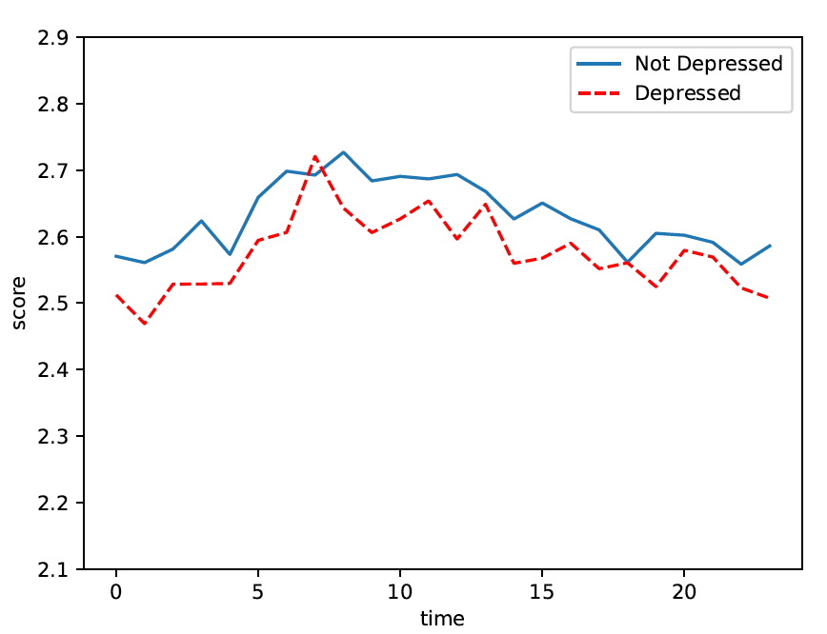
Mental Health Analysis
People with moderate or severe depression tend to write less specific posts
Regardless of the time of day
Average tweet specificity throughout the day.

Slide 36
Is specificity prediction useful in a downstream task?
Helped with Mental Health (Depression) Analysis!
4

Slide 37
Take Aways
1
New data set and predictive model for fine-grained specificity on social media
2
Social and temporal factors impact language specificity
3
Specificity prediction is useful in downstream analyses
Notes:
Social and temporal factors impact language specificity expressed on social media.
We introduce a sizable dataset with annotated specificity and a highly accurate specificity predictor @ specificityTwitter.
Specificity prediction is useful in characterizing moderate and severe depression.

Slide 38
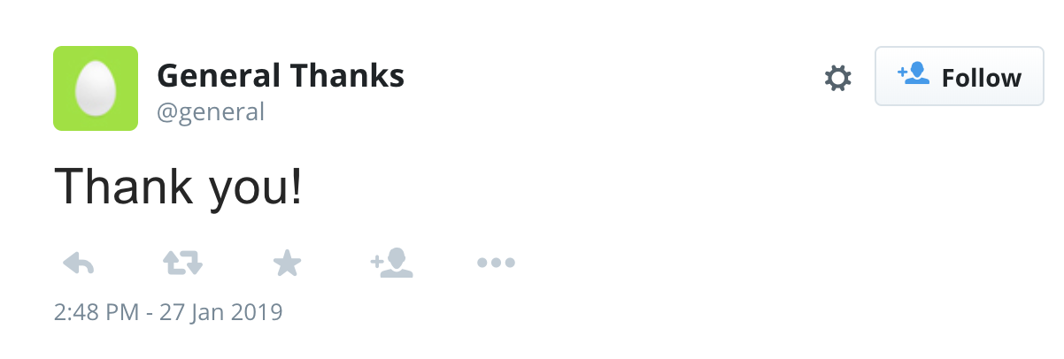
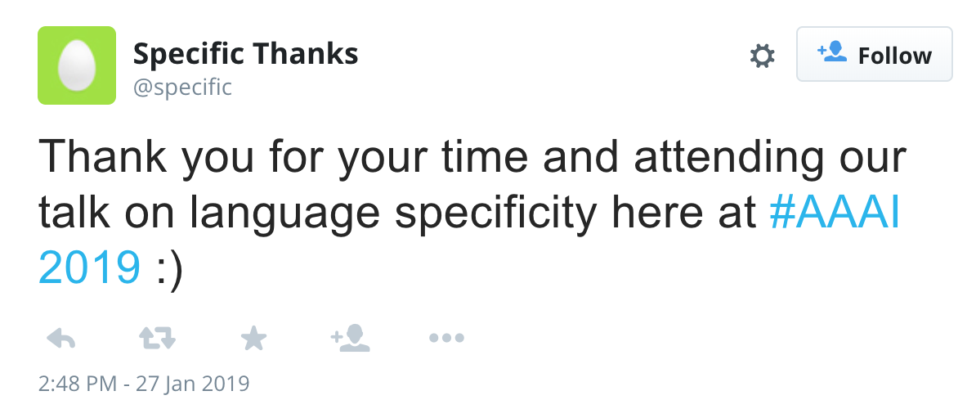
Thank You!
Contact:
Yifan Gao: yifan233@utexas.edu
Yang Zhong: yang.zhong@utexas.edu
Notes:
We can play here with: “Thank you” (quite general) “Thank you for your time and attending our talk on language specificity here at AAAI 2019” (specific)

